Slide 1
Pandas

Slide 2
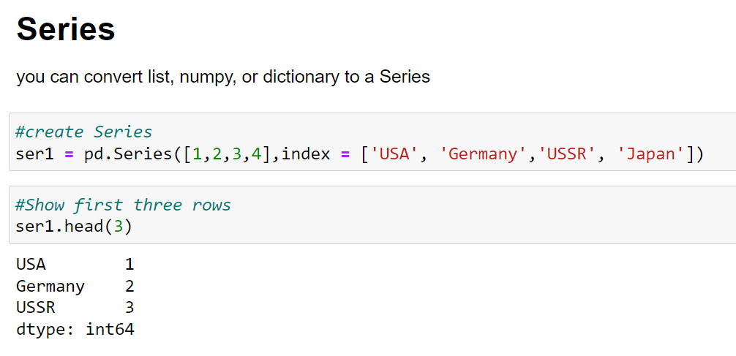
Pandas

Slide 3
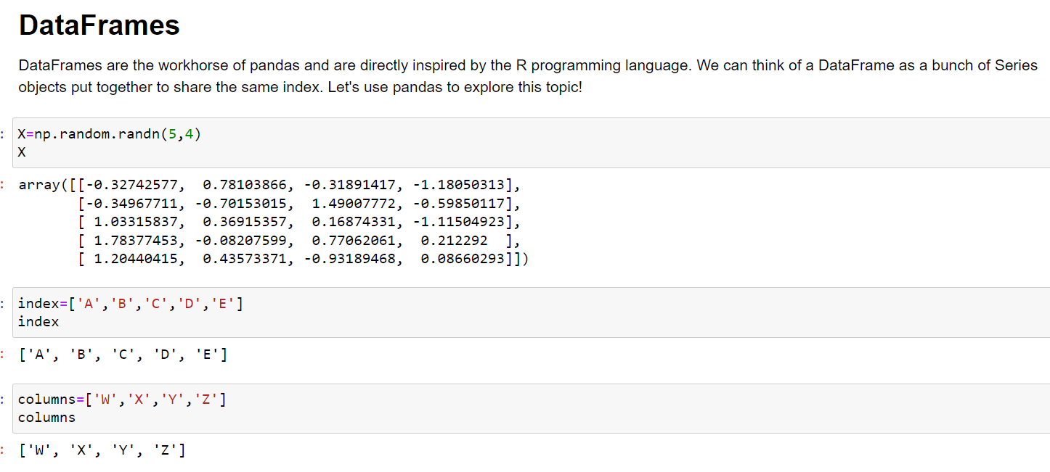
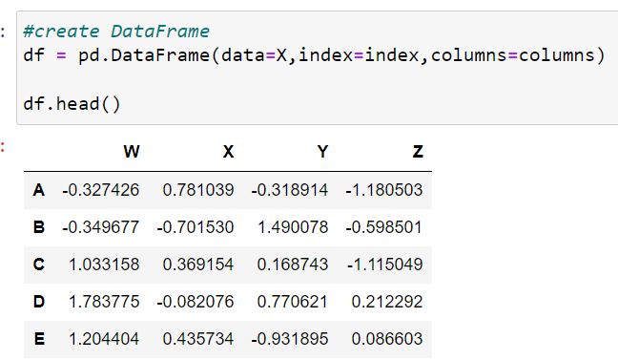
Pandas

Slide 4
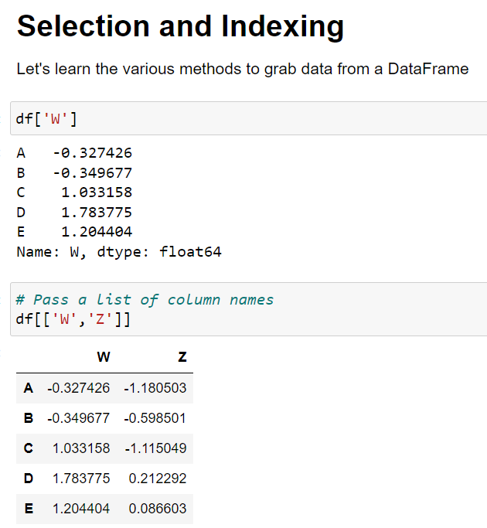
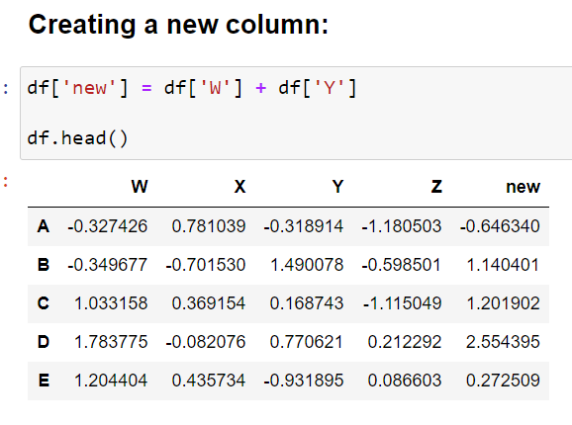
Pandas

Slide 5
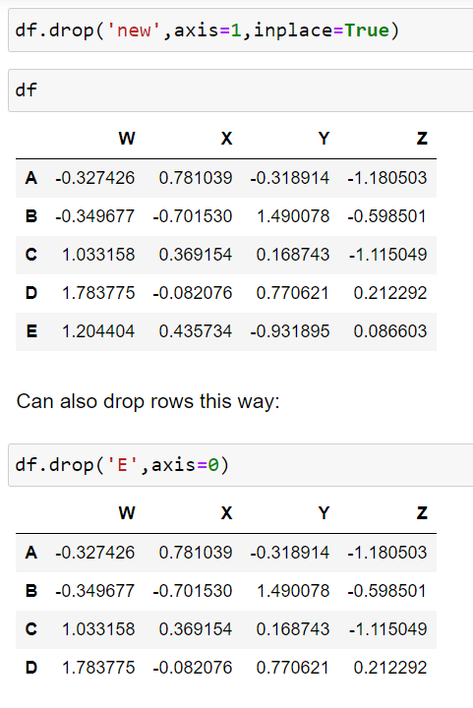
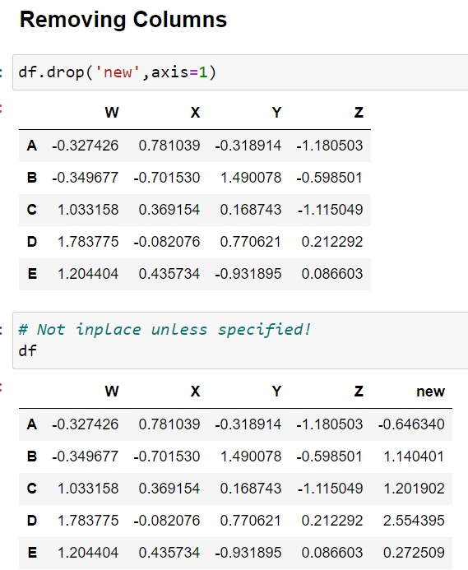
Pandas

Slide 6
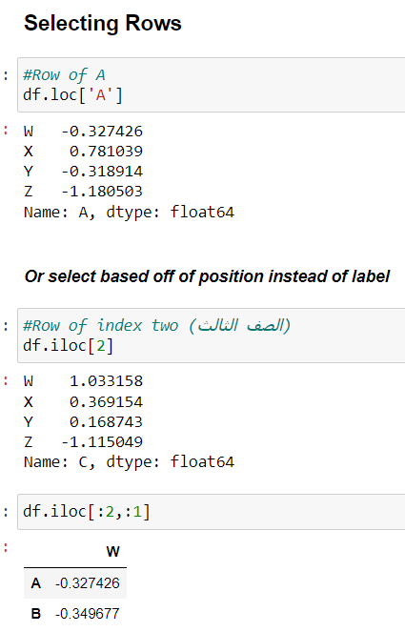
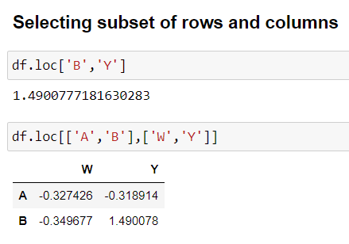
Pandas

Slide 7
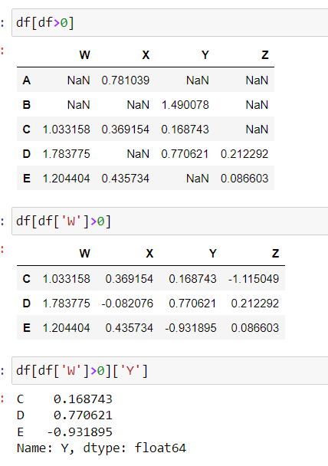
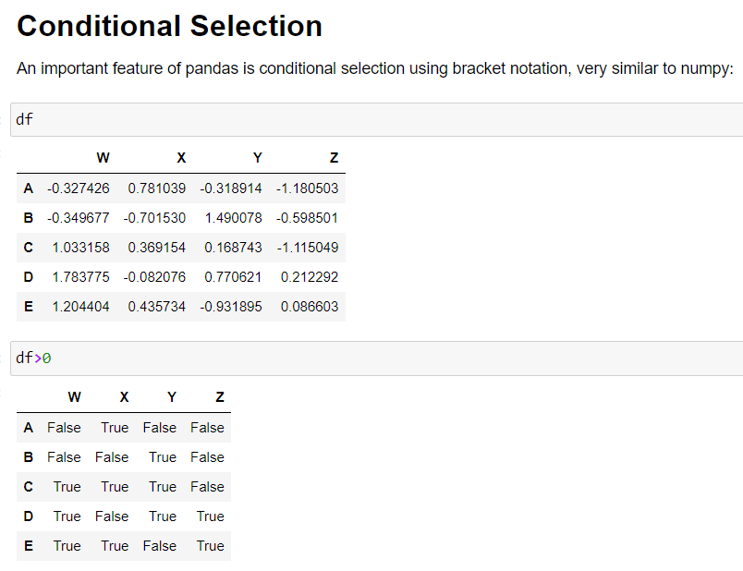
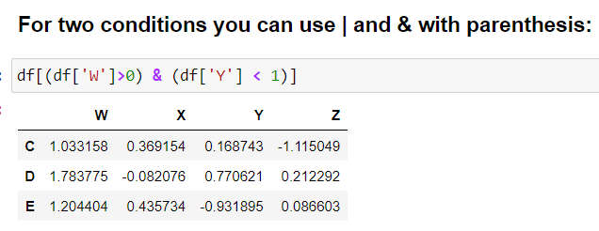
Pandas

Slide 8
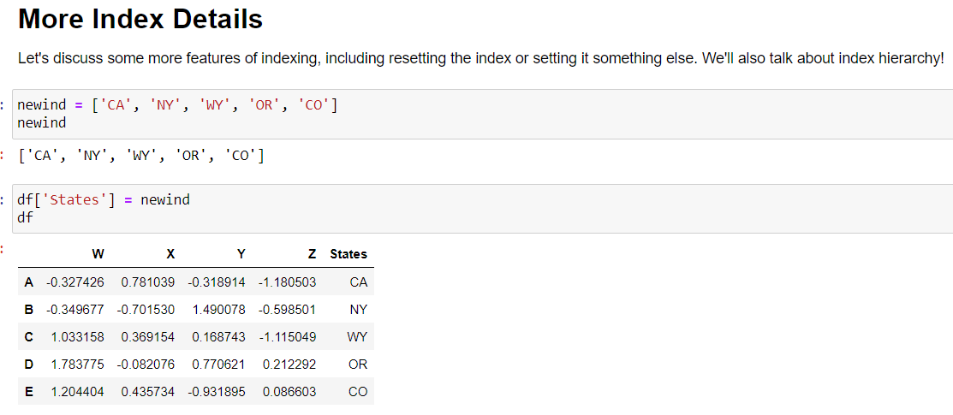
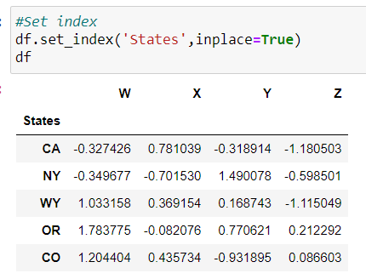
Pandas

Slide 9
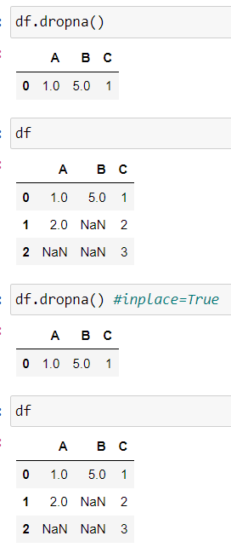
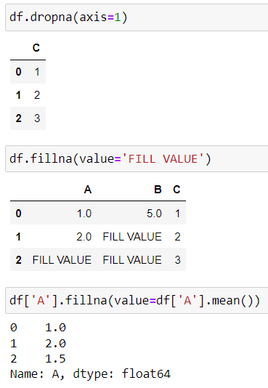
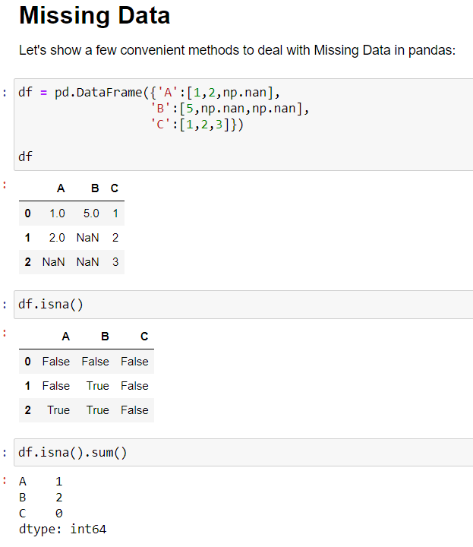
Pandas

Slide 10
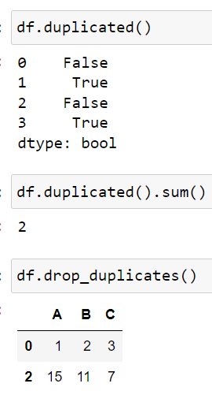
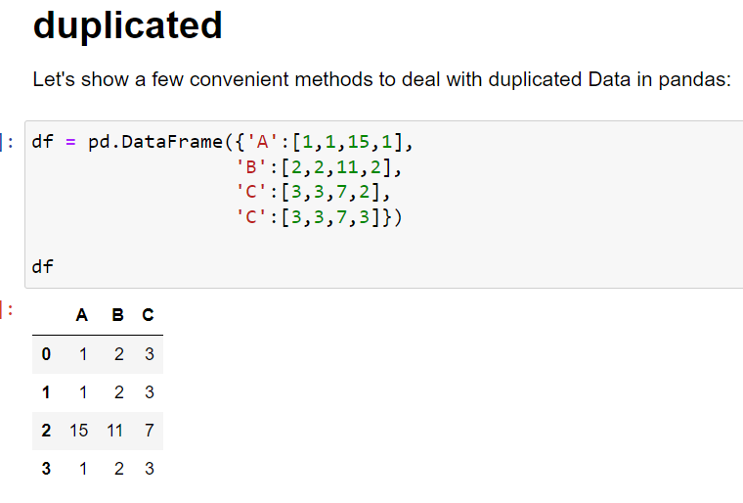
Pandas

Slide 11
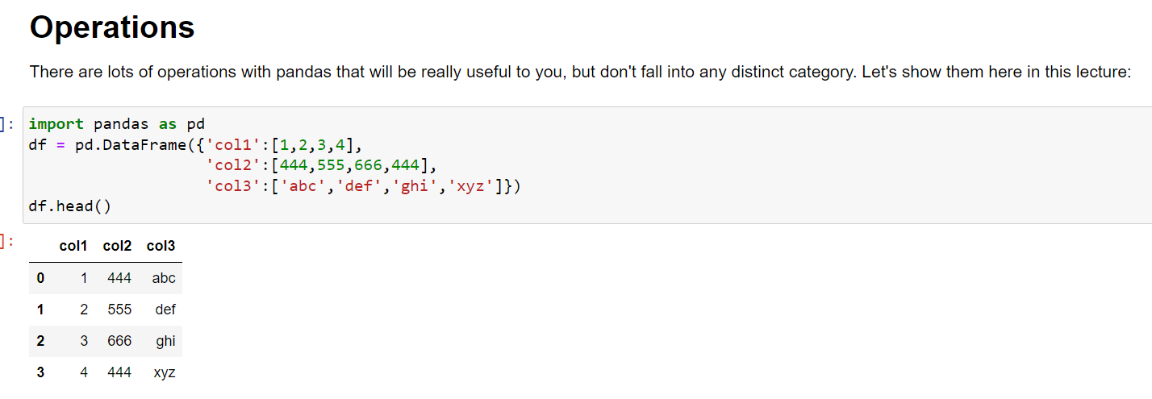
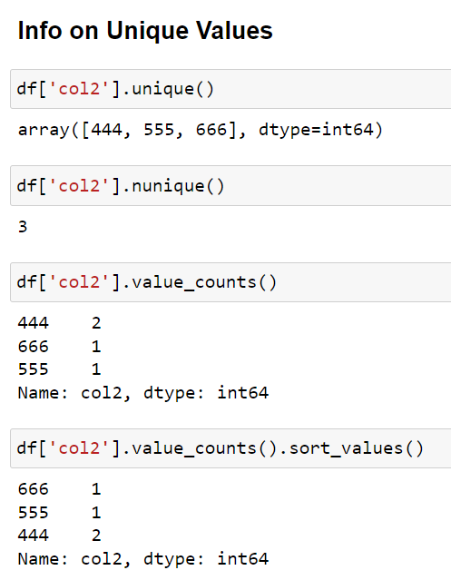
Pandas

Slide 12
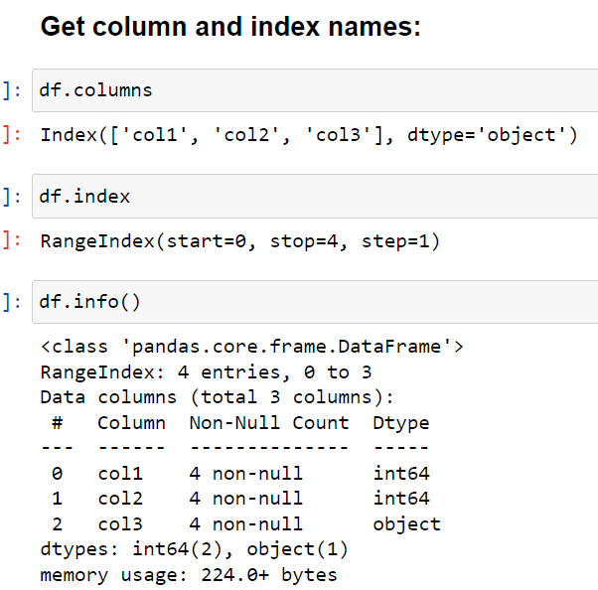
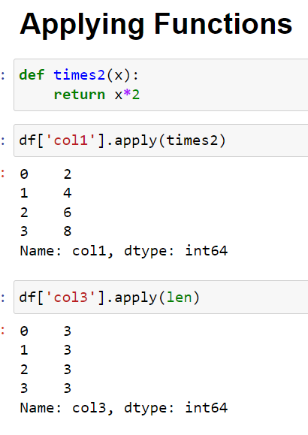
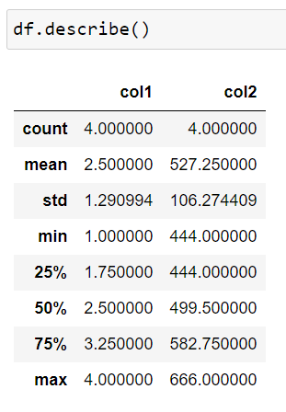
Pandas

Slide 13
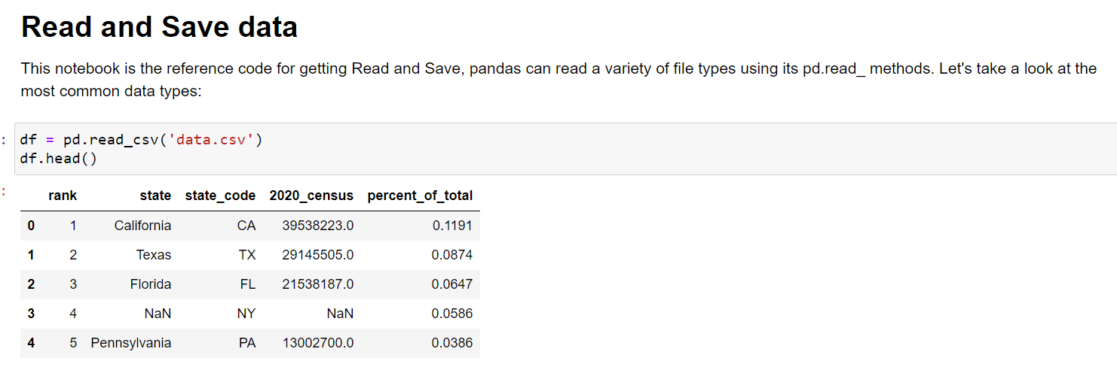
Pandas

Slide 14
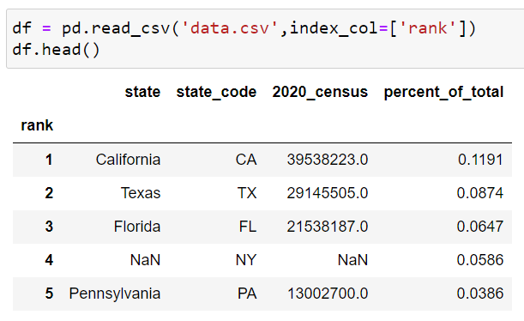
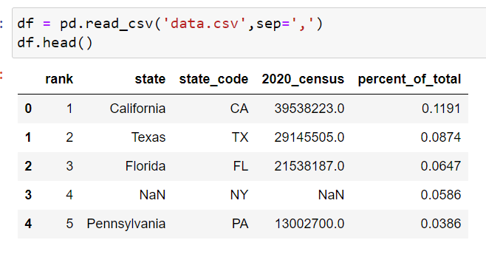
Pandas

Slide 15
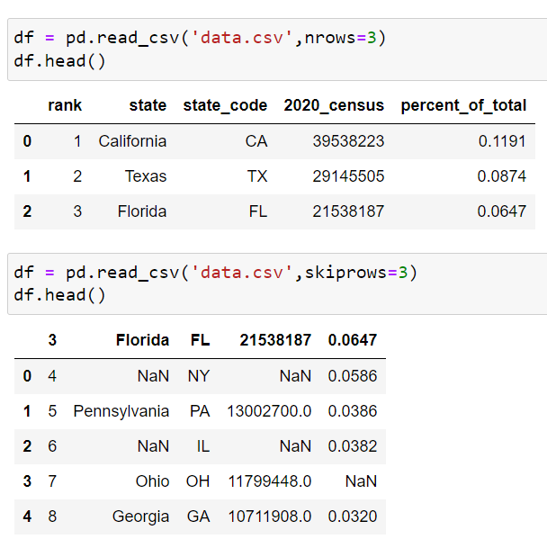
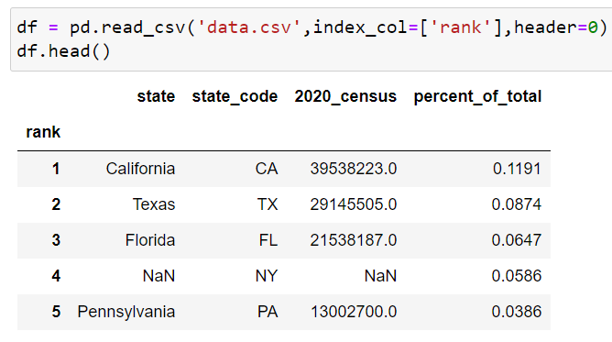
Pandas

Slide 16
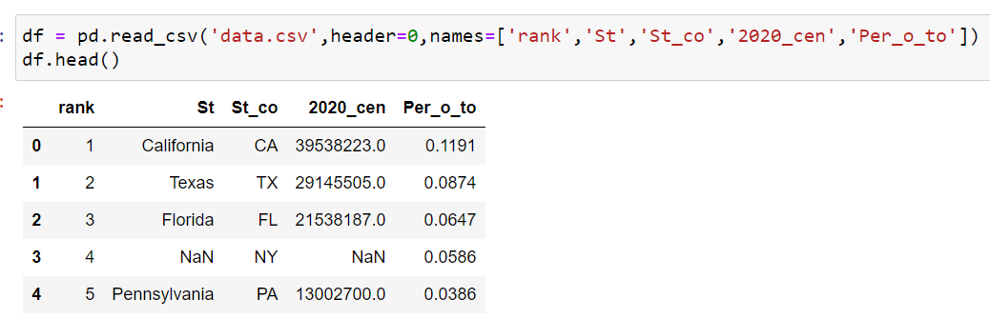
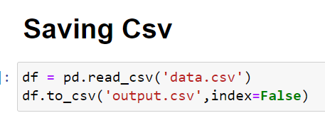
Pandas

Slide 17
matplotlib

Slide 18
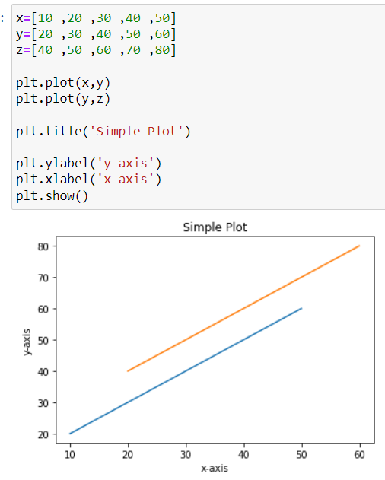
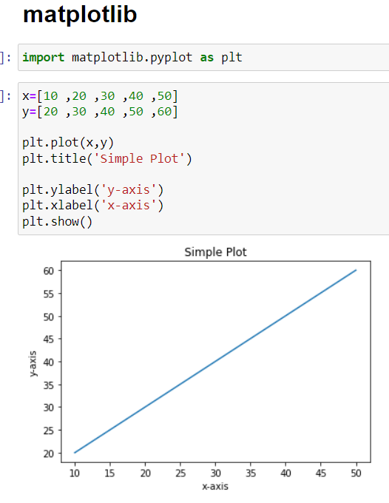
matplotlib

Slide 19
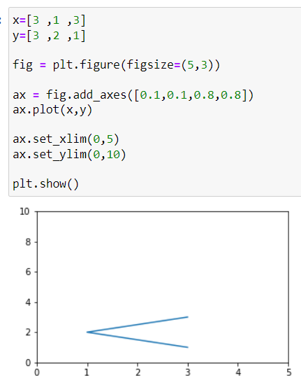
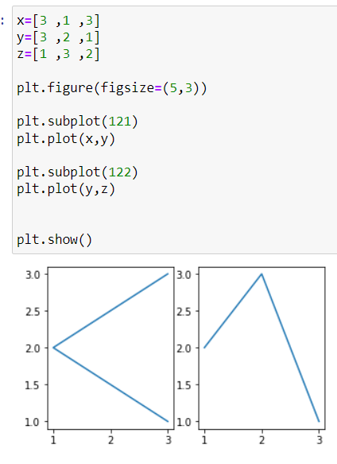
matplotlib

Slide 20
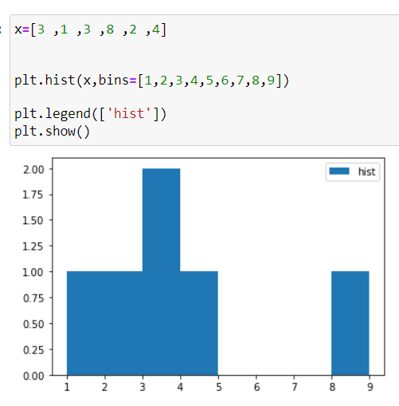
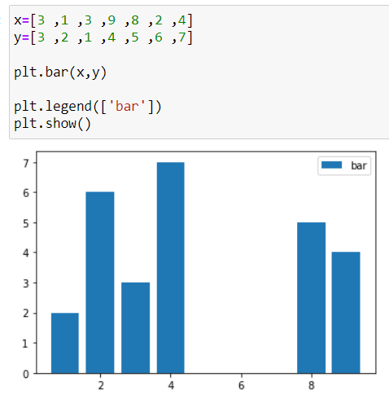
matplotlib

Slide 21
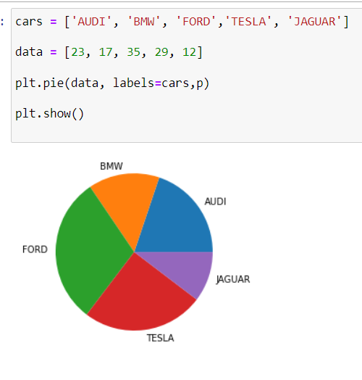
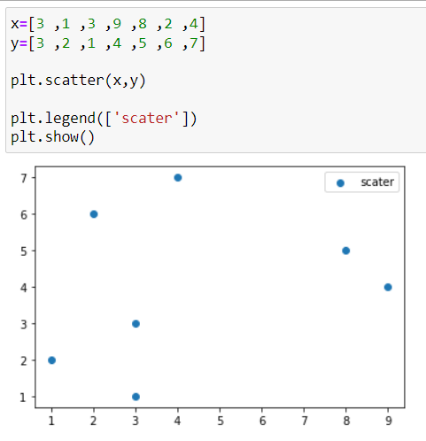
matplotlib

Slide 22
Machine learning
Introduction

Slide 23



What is machine learning
Model
Data
Learn a Task
Don’t tell me if-then rules, Just give me the data and I will learn the task

Slide 24
Types of machine learning: (1) Supervised Learning
Input
Output
Input and output are known
The model learns the relationship between input and output

Slide 25
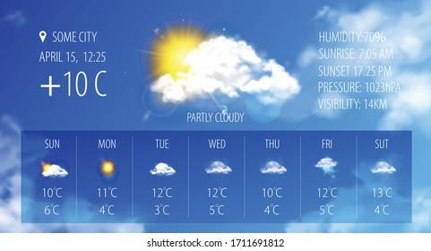
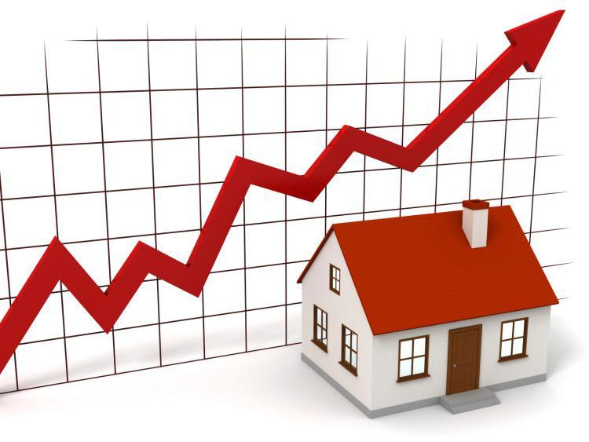

Supervised Learning Examples:
Regression
Predicting Stock Market Changes
Predicting temperature
Predicting House Prices

Slide 26
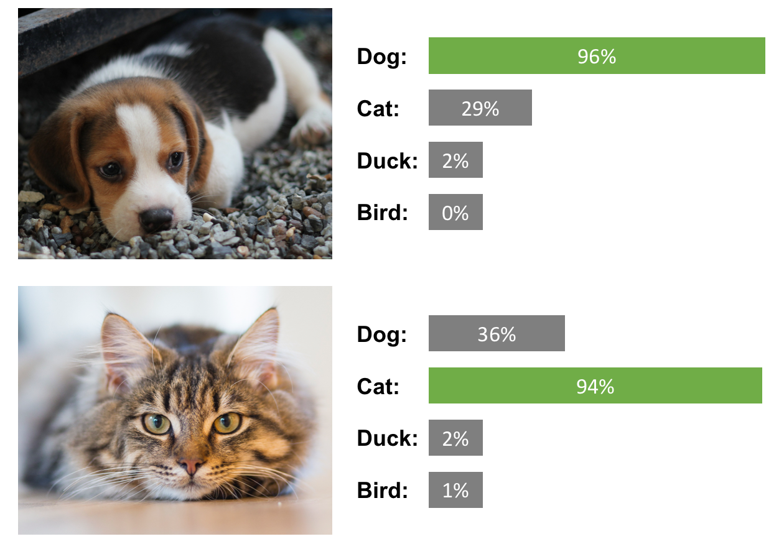


Supervised Learning Examples:
Classification
Medical diagnosis (disease classification)
Email classification (Spam/not spam)
Image classification

Slide 27
Types of machine learning: (2) Unsupervised Learning
Input
Output
Only Input is known
The model performs a task with the input such as:
Grouping similar objects together (Clustering)

Slide 28
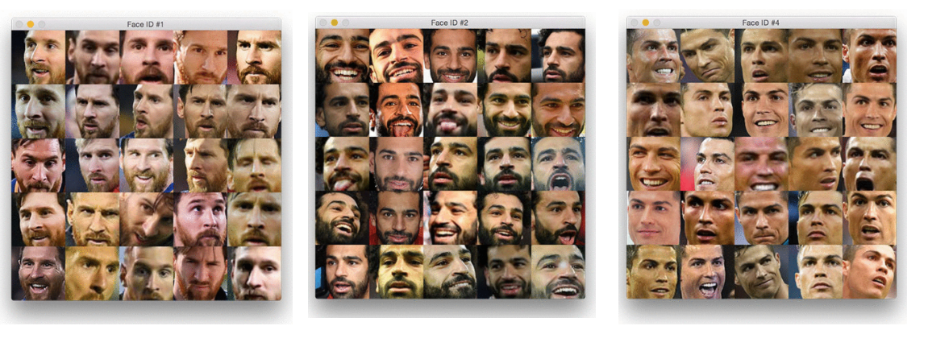
Unsupervised Learning Examples:
Clustering
Grouping similar images together

Slide 29



Types of machine learning: (3) Reinforcement Learning
simulation
Inside a simulation: An agent learns a task by interacting with the environment using trial and error

Slide 30
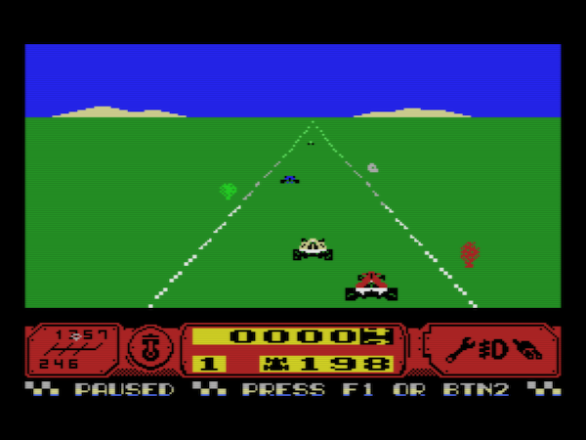
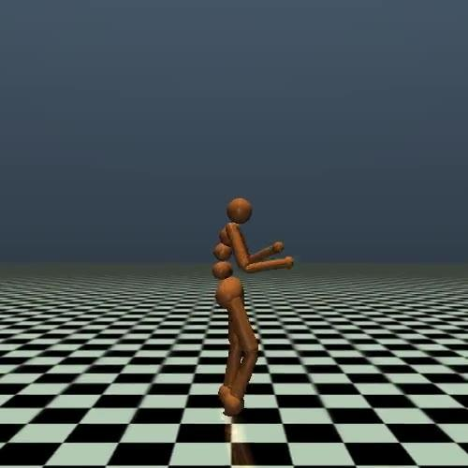
Reinforcement Learning Examples:
Learning to play a game
Learning how to walk

Slide 31
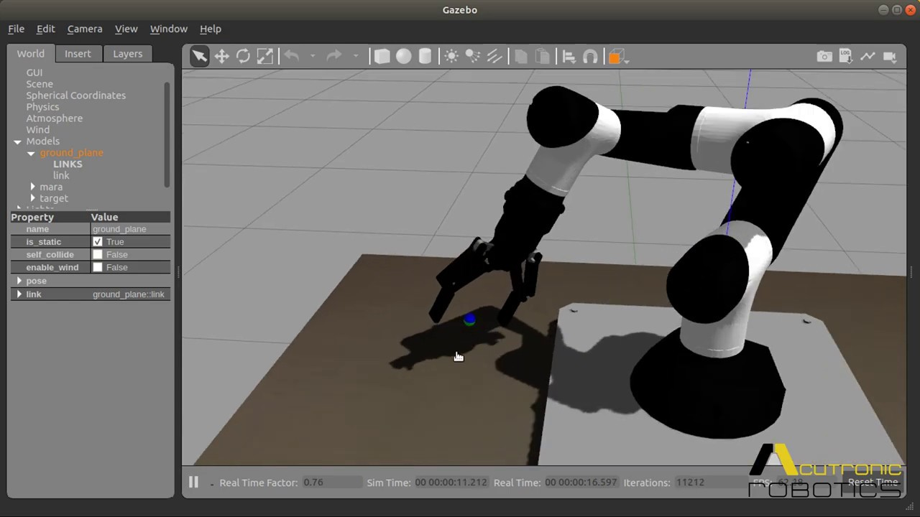

Reinforcement Learning Examples:
Learning to control a robotic arm
Autonomous drone

Slide 32
Dataset (Structured data)
Inputs (features/attributes)
desired output (target)
house age | distance to nearest MRT Station | Convenience Stores | price per unit area
32 | 84.88 | 10 | 37.9
19.5 | 306.59 | 9 | 42.2
13.3 | 561.98 | 5 | 47.3
5 | 390.57 | 5 | 54.8
7.1 | 2175.03 | 3 | 32.1
Each row is called sample,
or instance,
or pattern
Examples of structured data: Excel files or SQL databases

Slide 33




Unstructured data

Slide 34
Machine Learning Models (examples)
Linear/Non-linear regression
Logistic regression
Naïve Bayes Classifier
K Nearest Neighbors
Decision Tree
Random Forest
Support Vector Machine
Ensemble Models
Neural Network

Slide 35





Machine learning engineering
Understanding objective
Building machine learning model
Model deployment
Model testing

Slide 36
Getting dataset

Slide 37
We can download free data from
UCI Machine Learning Repository: https://archive.ics.uci.edu/ml/datasets.php
Kaggle datasets: https://www.kaggle.com/datasets
Google dataset search: https://datasetsearch.research.google.com/

Slide 38
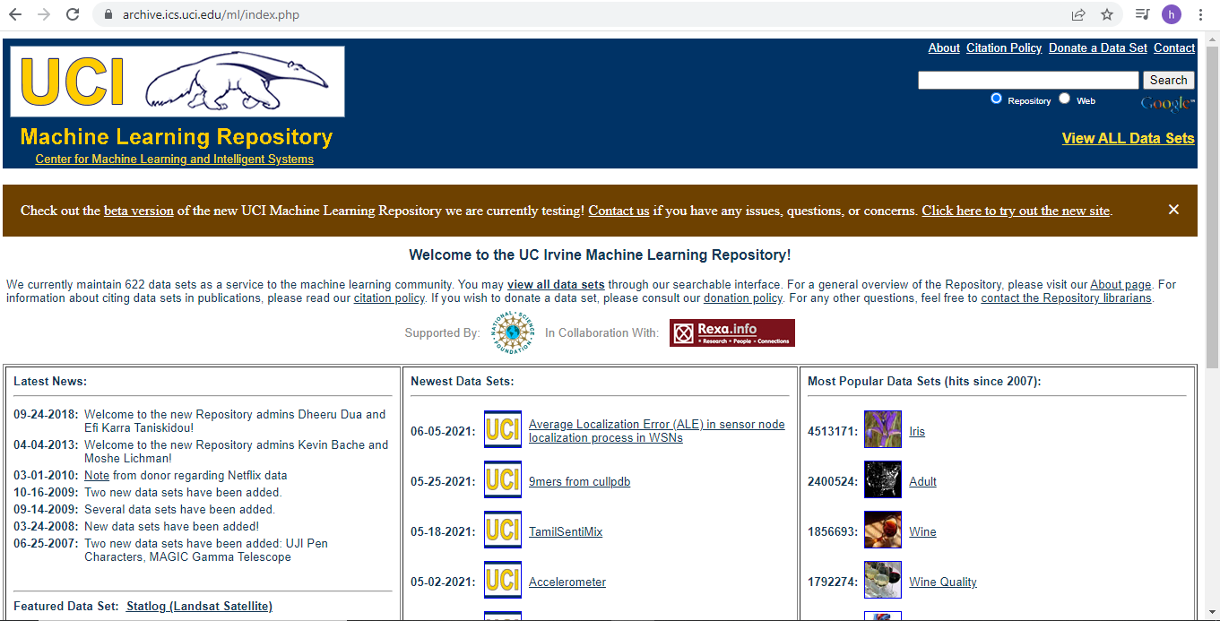
UCI Machine Learning Repository

Slide 39
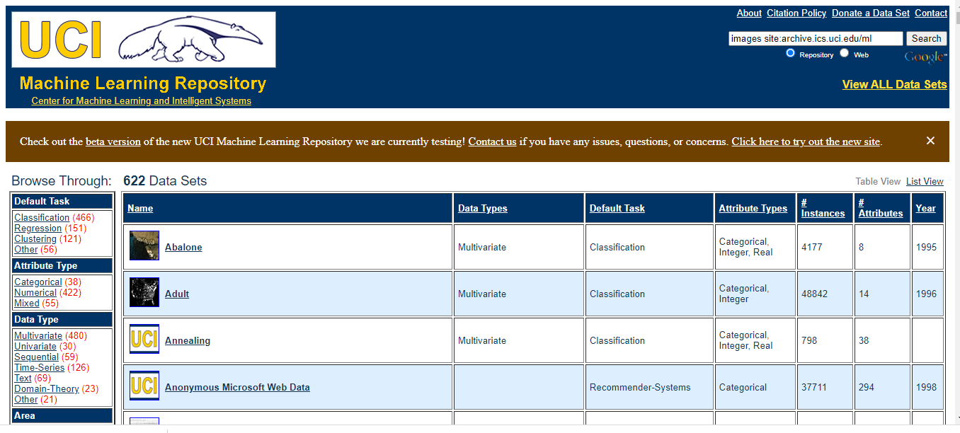

Slide 40
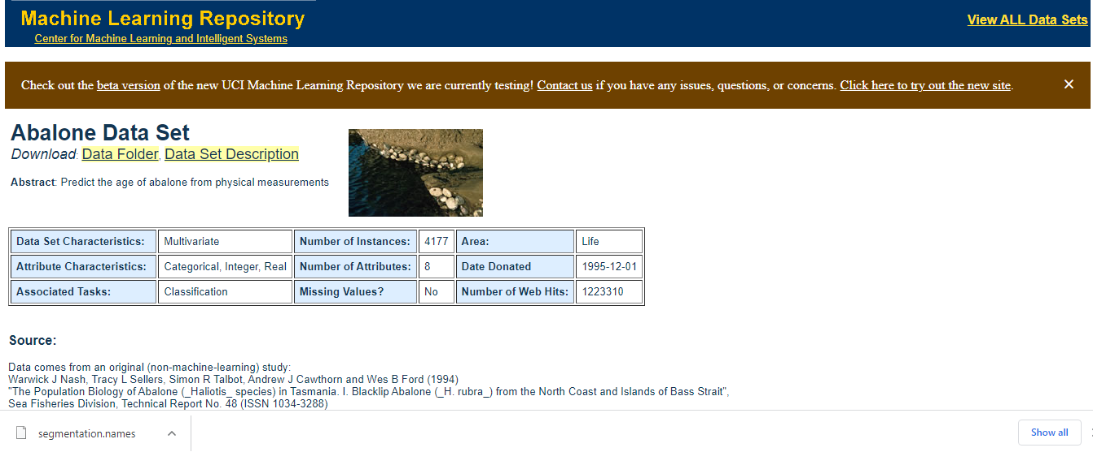

Slide 41
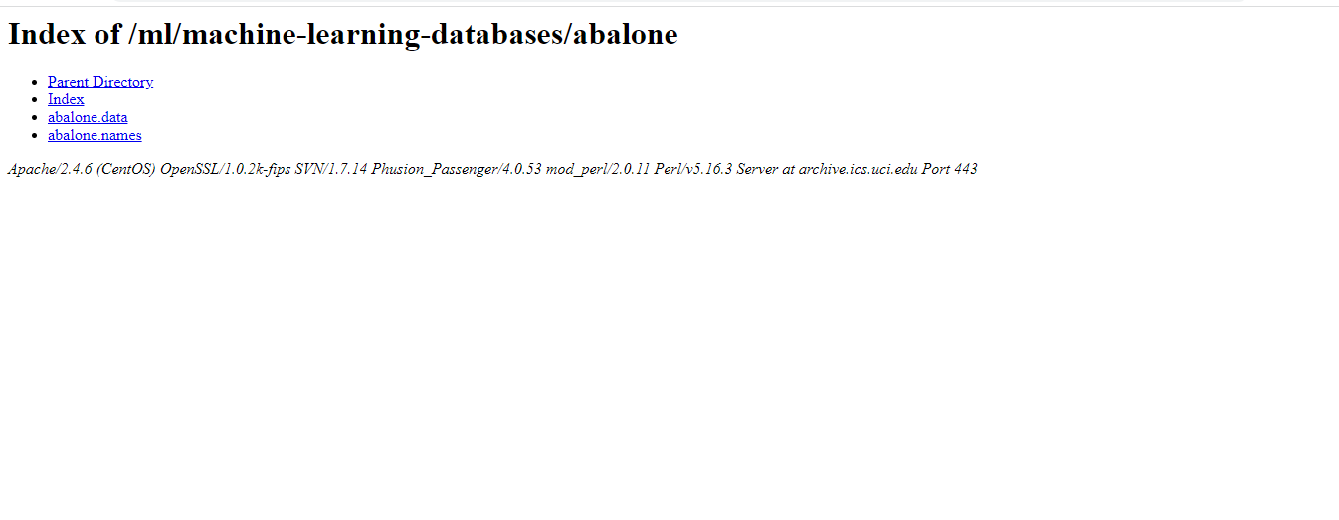

Slide 42

Kaggle datasets

Slide 43


Slide 44


Slide 45

Google dataset search

